Slide 1
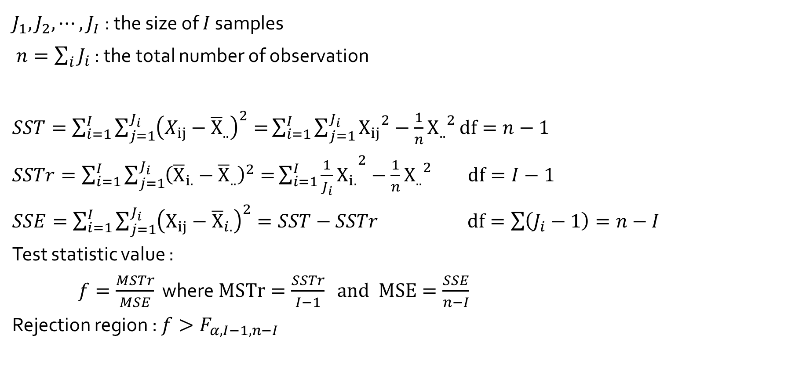
Unequal Sample Sizes
$J_{1}, J_{2},⋯,J_{I}$: the size of $I$ samples
$n=\sum_{i}{J_{i}}$ : the total number of observation
$SST=\sum_{i=1}^{I}{\sum_{j=1}^{J_{i}}{{\left(X_{ij}−{\overline{X}}_{..}\right)}^{2}=}}\sum_{i=1}^{I}{\sum_{j=1}^{J_{i}}{{X_{ij}}^{2}−\frac{1}{n}{X_{..}}^{2}}}$ $df=n−1$
$SSTr=\sum_{i=1}^{I}{\sum_{j=1}^{J_{i}}{{\left({\overline{X}}_{i.}−{\overline{X}}_{..}\right)}^{2}=}}\sum_{i=1}^{I}{{\frac{1}{J_{i}}X_{i.}}^{2}}−\frac{1}{n}{X_{..}}^{2}$ $df=I−1$
$SSE=\sum_{i=1}^{I}{\sum_{j=1}^{J_{i}}{{\left(X_{ij}−{\overline{X}}_{i.}\right)}^{2}}}=SST−SSTr$ $df=\sum{\left(J_{i}−1\right)=n−I}$
Test statistic value :
$f=\frac{MSTr}{MSE}$ where $MSTr=\frac{SSTr}{I−1} and MSE=\frac{SSE}{n−I}$
Rejection region : $f>F_{α, I−1, n−I}$

Slide 2
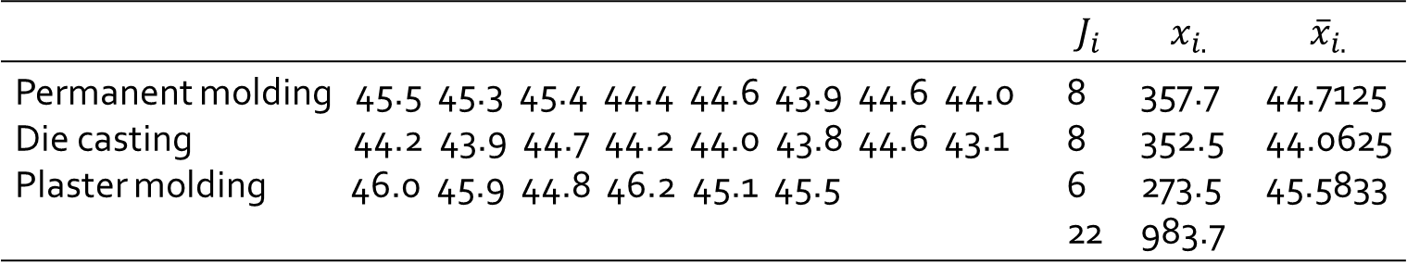
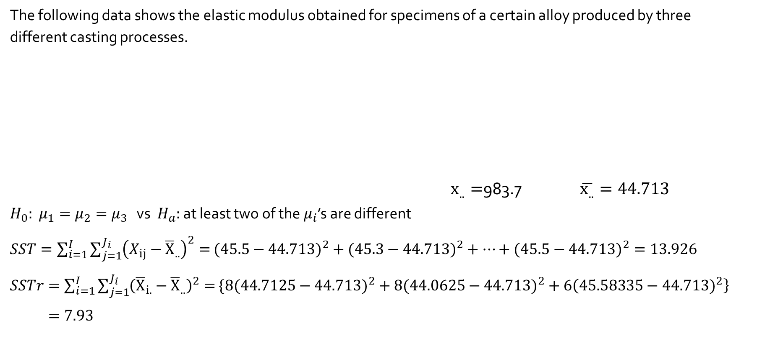
Example 10.9
The following data shows the elastic modulus obtained for specimens of a certain alloy produced by three different casting processes.
$x_{..}=$983.7 $\overline{x_{..}}=44.713$
$H_{0}:$ $μ_{1}=μ_{2}=μ_{3}$ vs $H_{a}:$ at least two of the $μ_{i}$’s are different
$SST=\sum_{i=1}^{I}{\sum_{j=1}^{J_{i}}{{\left(X_{ij}−{\overline{X}}_{..}\right)}^{2}=}}({45.5−44.713)}^{2}+({45.3−44.713)}^{2}+⋯+({45.5−44.713)}^{2}=13.926$
$SSTr=\sum_{i=1}^{I}{\sum_{j=1}^{J_{i}}{{\left({\overline{X}}_{i.}−{\overline{X}}_{..}\right)}^{2}=}}\{8({44.7125−44.713)}^{2}+8({44.0625−44.713)}^{2}+6\left({45.58335−44.713)}^{2}\right\}$
$=7.93$
 | $$J_{i}$$ | $$x_{i.}$$ | $${\overline{x}}_{i.}$$
Permanent molding 45.5 45.3 45.4 44.4 44.6 43.9 44.6 44.0 Die casting 44.2 43.9 44.7 44.2 44.0 43.8 44.6 43.1 Plaster molding 46.0 45.9 44.8 46.2 45.1 45.5 | 8 8 6 22 | 357.7 352.5 273.5 983.7 | 44.7125 44.0625 45.5833

Slide 3
Example 10.9
> modulus <- c(45.5, 45.3, 45.4, 44.4, 44.6, 43.9, 44.6, 44.0,
+ 44.2, 43.9, 44.7, 44.2, 44.0, 43.8, 44.6, 43.1,
+ 46.0, 45.9, 44.8, 46.2, 45.1, 45.5)
> type <- c(rep("1", 8), rep("2", 8), rep("3", 6))
> oneway <- aov(modulus ~ type)
> summary(oneway)
Df Sum Sq Mean Sq F value Pr(>F)
Type 2 7.930 3.965 12.56 0.000334 ***
Residuals 19 5.996 0.316
Source of Variation | df | Sum of Squares | Mean Square | f
Treatments Error Total | 2 19 21 | 7.93 5.996 13.93 | 3.965 0.316 | 12.56

Slide 4
Tukey’s Comparison : Example 10.9
> posthoc <- TukeyHSD(x=oneway, 'type', conf.level=0.95)
> posthoc
Tukey multiple comparisons of means
95% family-wise confidence level
Fit: aov(formula = modulus ~ type)
$`type`
diff lwr upr p adj
2-1 -0.6500000 -1.3635569 0.06355694 0.0780174
3-1 0.8708333 0.1001038 1.64156292 0.0253295
3-2 1.5208333 0.7501038 2.29156292 0.0002183

Slide 5

F Distribution and the F Test
$\sum{\sum{x_{i}^{2}}}=43998.73$ CF$=\frac{{983.7}^{2}}{22}=43984.8$
$SST=43998.73−43984.8=13.93$
$SSTr=\frac{{\left(357.7\right)}^{2}}{8}+\frac{{\left(352.5\right)}^{2}}{8}+\frac{{\left(273.5\right)}^{2}}{6}−43984.8=7.93$
$SSE=13.93−7.93=6.00$
Since 12.56 $≥F_{0.001, 2, 19}=10.16,{ H}_{0}$ is rejected at significance level 0.001.
Source of variation | df | Sum of squares | Mean square | f
Treatment Error Total | 2 19 21 | 7.93 6.00 13.93 | 3.965 0.3158 | 12.56

Slide 6
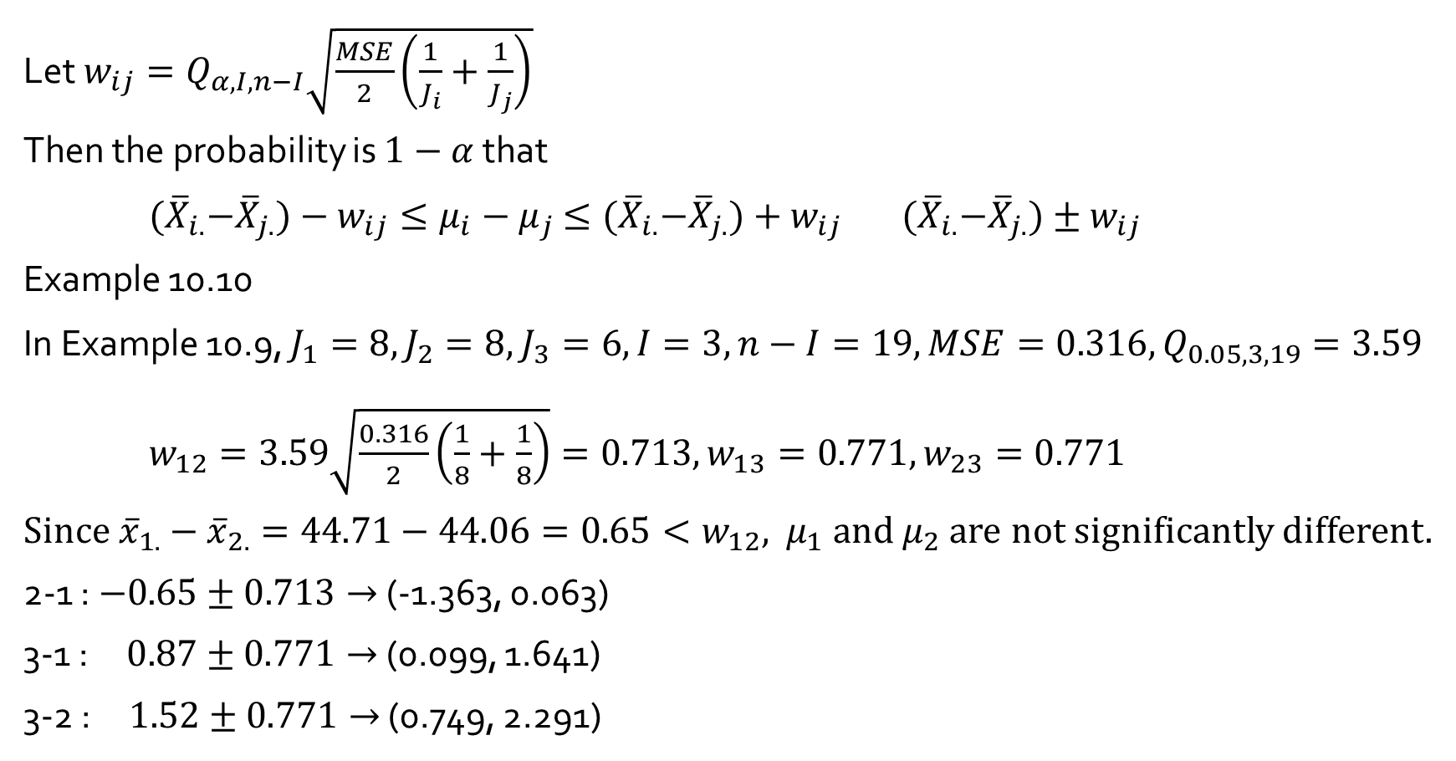
Let ${w_{ij}=Q}_{α, I,n−I}\sqrt{\frac{MSE}{2}\left(\frac{1}{J_{i}}+\frac{1}{J_{j}}\right)}$
Then the probability is $1−α$ that
${(\overline{X}}_{i.}−{\overline{X}}_{j.})−w_{ij}≤μ_{i}−μ_{j}$ $≤{(\overline{X}}_{i.}−{\overline{X}}_{j.})+w_{ij}$ ${(\overline{X}}_{i.}−{\overline{X}}_{j.})±w_{ij}$
Example 10.10
In Example 10.9, $J_{1}=8, J_{2}=8,$ $J_{3}=6,I=3,n−I=19, MSE=0.316, Q_{0.05, 3, 19}=3.59$
$w_{12}=3.59\sqrt{\frac{0.316}{2}\left(\frac{1}{8}+\frac{1}{8}\right)}=0.713, w_{13}=0.771,w_{23}=0.771$
Since ${\overline{x}}_{1.}−{\overline{x}}_{2.}=44.71−44.06=0.65<w_{12}$, $μ_{1}$ and $μ_{2}$ are not significantly different.
2-1 : $−0.65±0.713→$ (-1.363, 0.063)
3-1 : $0.87±0.771→$ (0.099, 1.641)
3-2 : $1.52±0.771→$ (0.749, 2.291)

